Slide 1
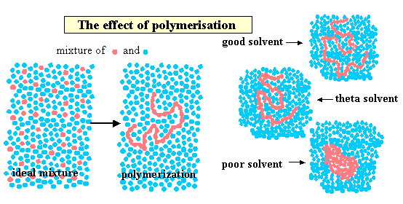
Chemical Engineering Thermodynamics Lecture 8 Solution Thermodynamics Xiaofei Xu

Slide 2
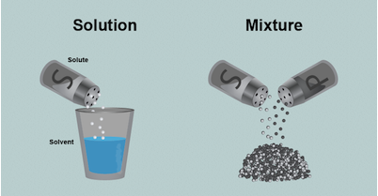
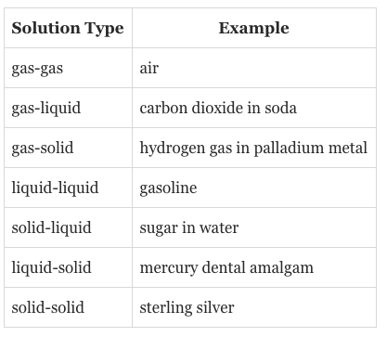
Solutions and Mixtures
Solutions are homogeneous mixtures

Slide 3

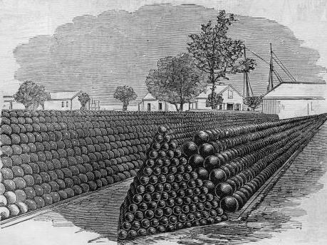
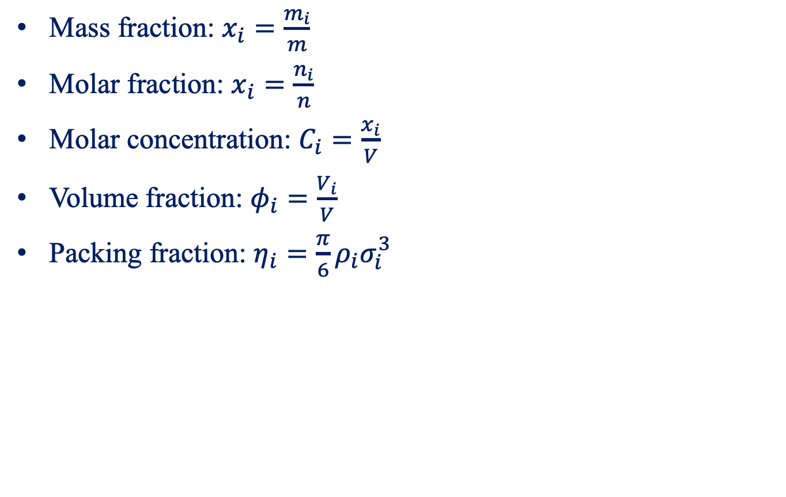
Measures of Composition
Mass fraction: $x_{i}=\frac{m_{i}}{m}$
Molar fraction: $x_{i}=\frac{n_{i}}{n}$
Molar concentration: $C_{i}=\frac{x_{i}}{V}$
Volume fraction: $φ_{i}=\frac{V_{i}}{V}$
Packing fraction: $η_{i}=\frac{π}{6}ρ_{i}σ_{i}^{3}$

Slide 4
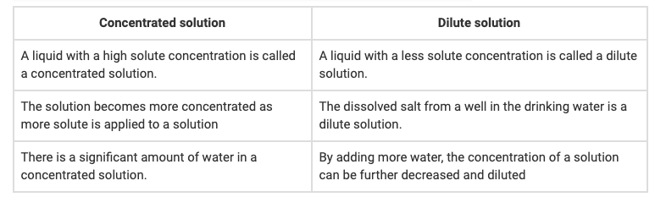
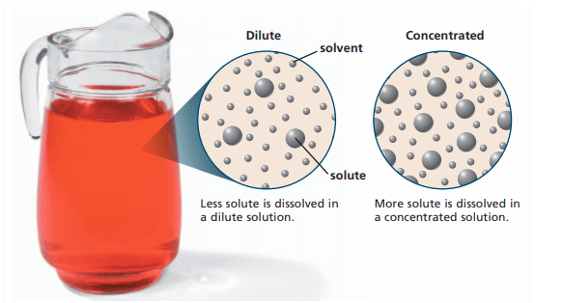
Dilute and Concentrated Solution

Slide 5
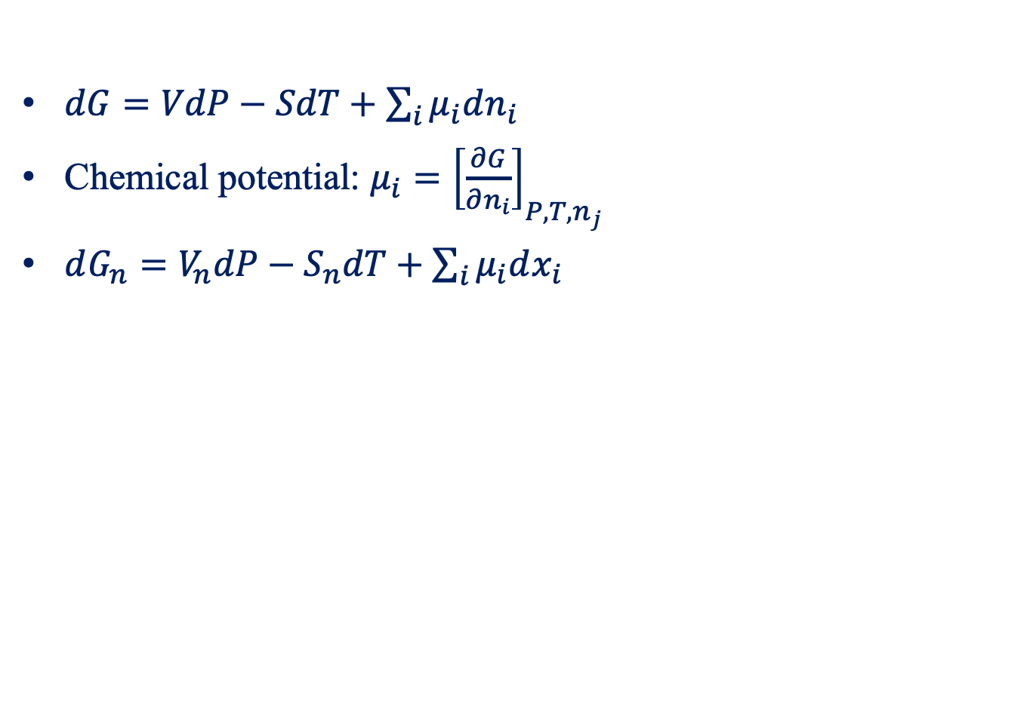
Fundamental Property Relation
$dG=VdP−SdT+\sum_{i}{μ_{i}dn_{i}}$
Chemical potential: $μ_{i}={\left[\frac{∂G}{∂n_{i}}\right]}_{P,T, n_{j}}$
$dG_{n}=V_{n}dP−S_{n}dT+\sum_{i}{μ_{i}dx_{i}}$

Slide 6
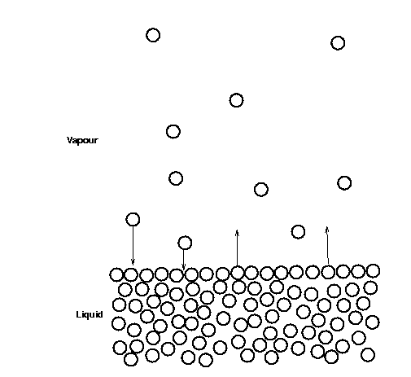
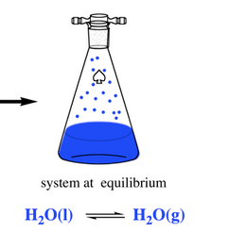
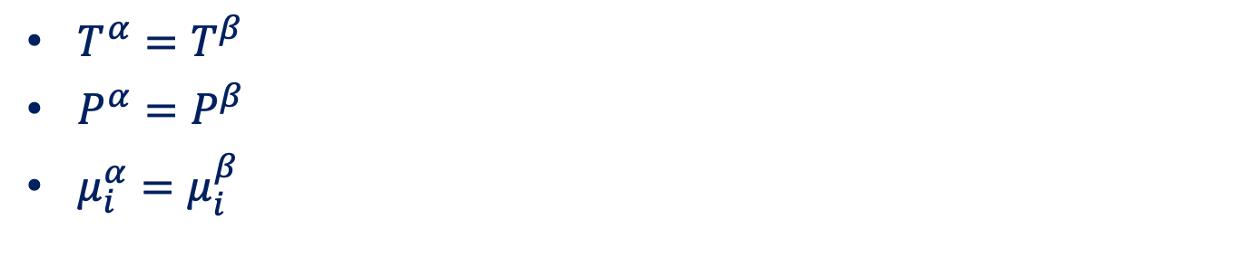
Phase Equilibrium
$T^{α}=T^{β}$
$P^{α}=P^{β}$
$μ_{i}^{α}=μ_{i}^{β}$

Slide 7
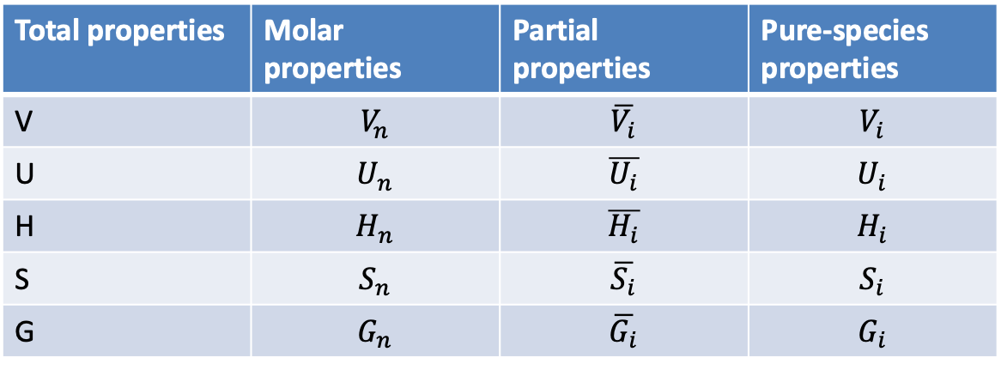
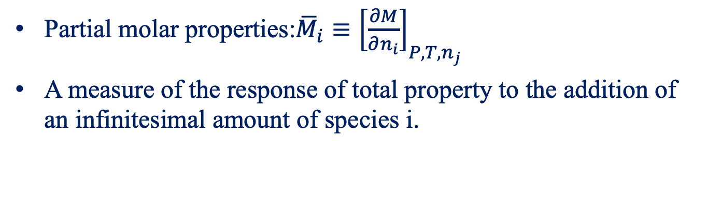
Partial Properties
Partial molar properties:${\overline{M}}_{i}≡{\left[\frac{∂M}{∂n_{i}}\right]}_{P,T, n_{j}}$
A measure of the response of total property to the addition of an infinitesimal amount of species i.
Total properties | Molar properties | Partial properties | Pure-species properties
V | $$V_{n}$$ | $$\overline{V_{i}}$$ | $$V_{i}$$
U | $$U_{n}$$ | $$\overline{U_{i}}$$ | $$U_{i}$$
H | $$H_{n}$$ | $$\overline{H_{i}}$$ | $$H_{i}$$
S | $$S_{n}$$ | $$\overline{S_{i}}$$ | $$S_{i}$$
G | $$G_{n}$$ | $$\overline{G_{i}}$$ | $$G_{i}$$

Slide 8
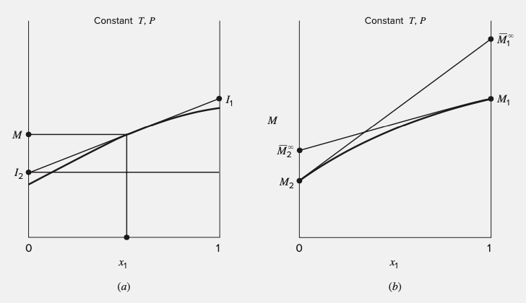
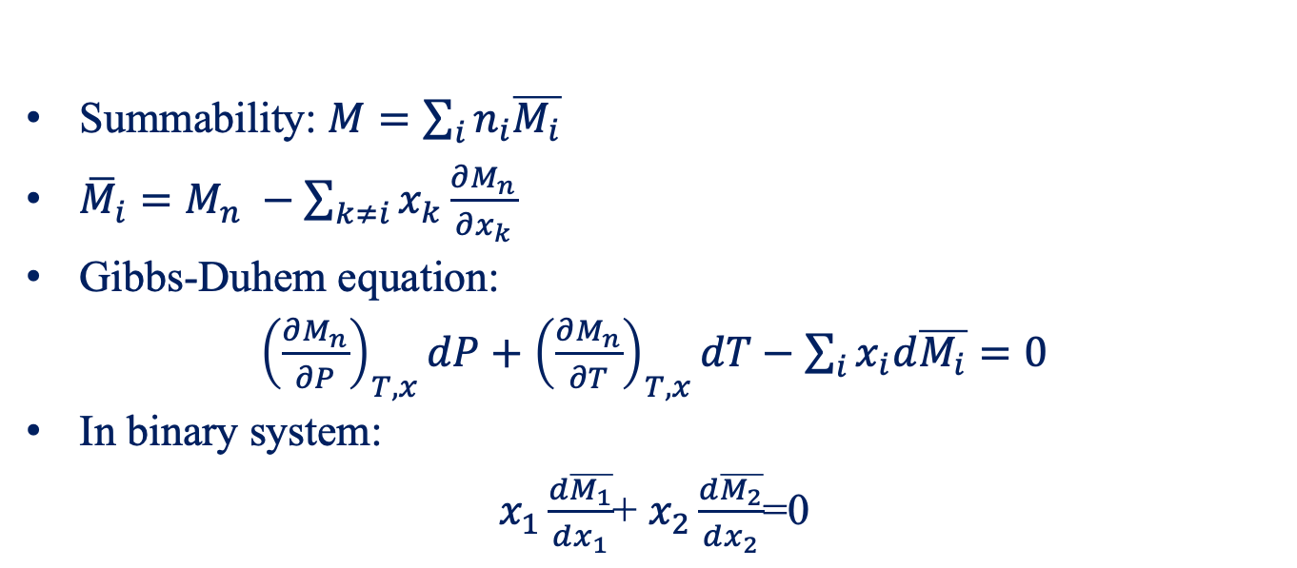
Some Important Formulars
Summability: $M=\sum_{i}{n_{i}\overline{M_{i}}}$
${\overline{M}}_{i}=M_{n} −\sum_{k≠i}{x_{k}\frac{∂M_{n}}{∂x_{k}}}$
Gibbs-Duhem equation:
${\left(\frac{∂M_{n}}{∂P}\right)}_{T,x}dP+$ ${\left(\frac{∂M_{n}}{∂T}\right)}_{T,x}dT−\sum_{i}{x_{i}d\overline{M_{i}}}=0$
In binary system:
$x_{1}\frac{d\overline{M_{1}}}{dx_{1}}$+ $x_{2}\frac{d\overline{M_{2}}}{dx_{2}}$=0

Slide 9
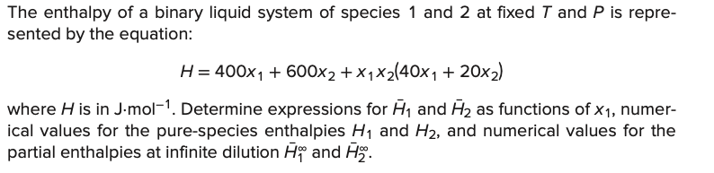
Example
Molar enthalpy

Slide 10
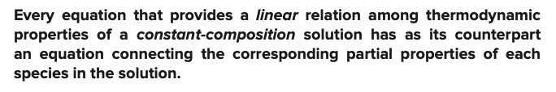
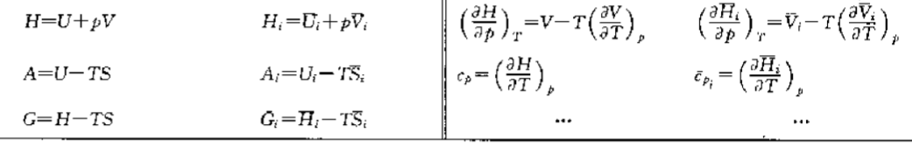
Partial Properties

Slide 11
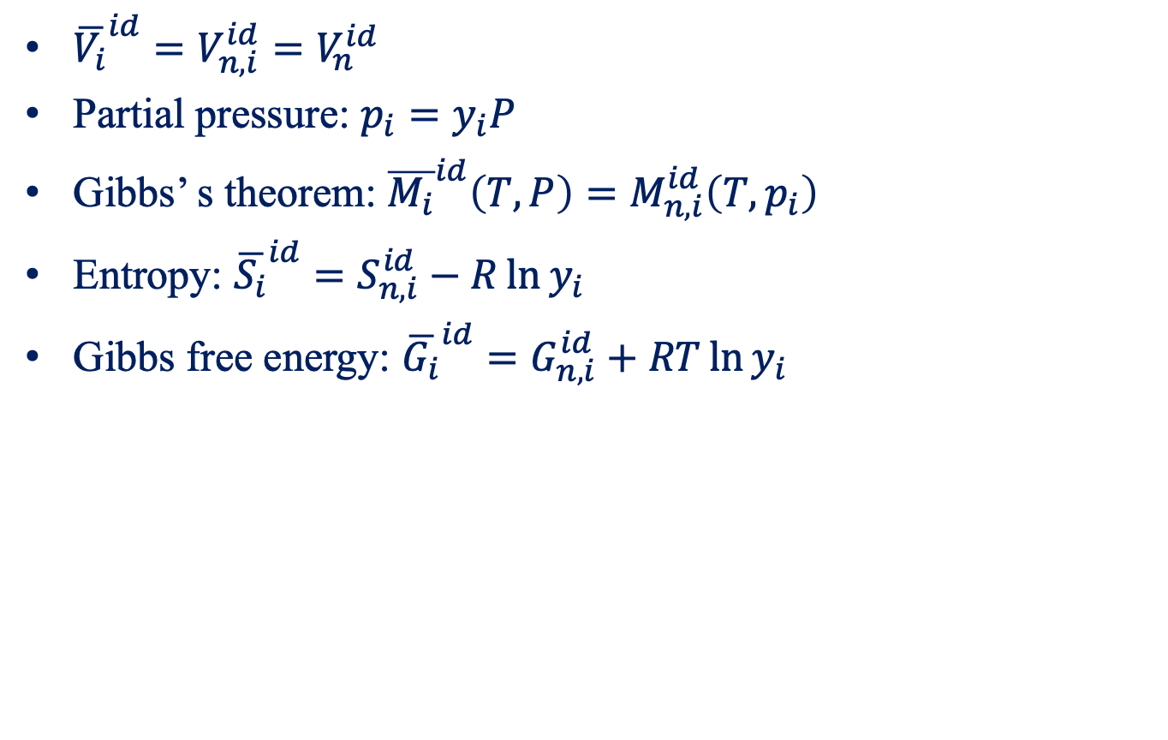
The Ideal-Gas-State Mixture Model
${\overline{V_{i}}}^{id}=V_{n,i}^{id}=V_{n}^{id}$
Partial pressure: $p_{i}=y_{i}P$
Gibbs’ s theorem: ${\overline{M_{i}}}^{id}\left(T,P\right)=M_{n,i}^{id}\left(T,p_{i}\right)$
Entropy: ${\overline{S_{i}}}^{id}=S_{n,i}^{id}−R\ln{y_{i}}$
Gibbs free energy: ${\overline{G_{i}}}^{id}=G_{n,i}^{id}+RT\ln{y_{i}}$

Slide 12
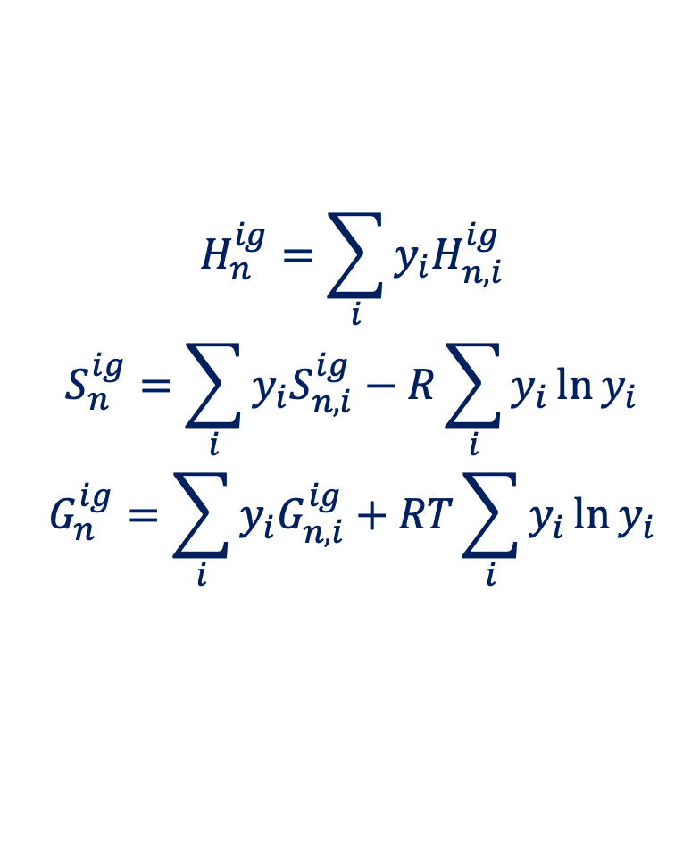
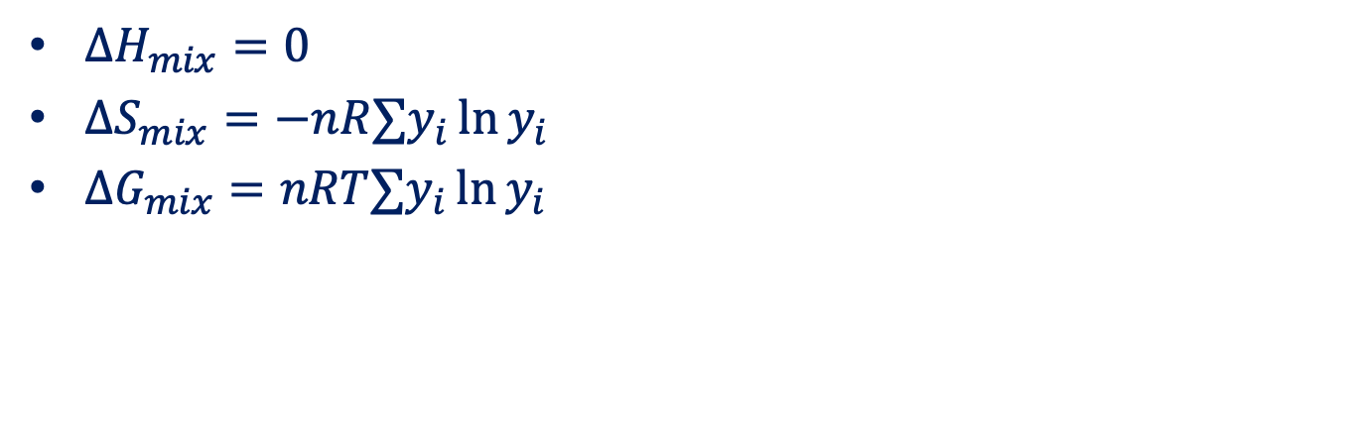
Mixing in ideal-gas state
$$H_{n}^{ig}=\sum_{i}{y_{i}H_{n,i}^{ig}}$$
$$S_{n}^{ig}=\sum_{i}{y_{i}S_{n,i}^{ig}−R\sum_{i}{y_{i}\ln{y_{i}}}}$$
$$G_{n}^{ig}=\sum_{i}{y_{i}G_{n,i}^{ig}}+RT\sum_{i}{y_{i}\ln{y_{i}}}$$
$ΔH_{mix}=0$
$ΔS_{mix}=−nR∑y_{i}\ln{y_{i}}$
$ΔG_{mix}=nRT∑y_{i}\ln{y_{i}}$

Slide 13
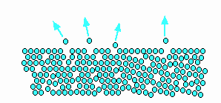
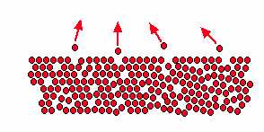
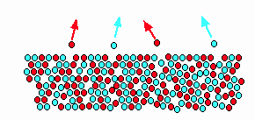
Fugacity
In an ideal mixture, the tendency of the two types of molecules to escape is the same as that in pure species.
In a real mixture, the tendency depends on the interaction between molecules.

Slide 14
Fugacity
A measure of the tendency of a fluid to escape or expand
Measure the behaviors deviating from ideal-gas
Depends on molecular interactions
The pressure value needed at a given T to make the properties of a non-ideal gas satisfy the equation for an ideal gas

Slide 15
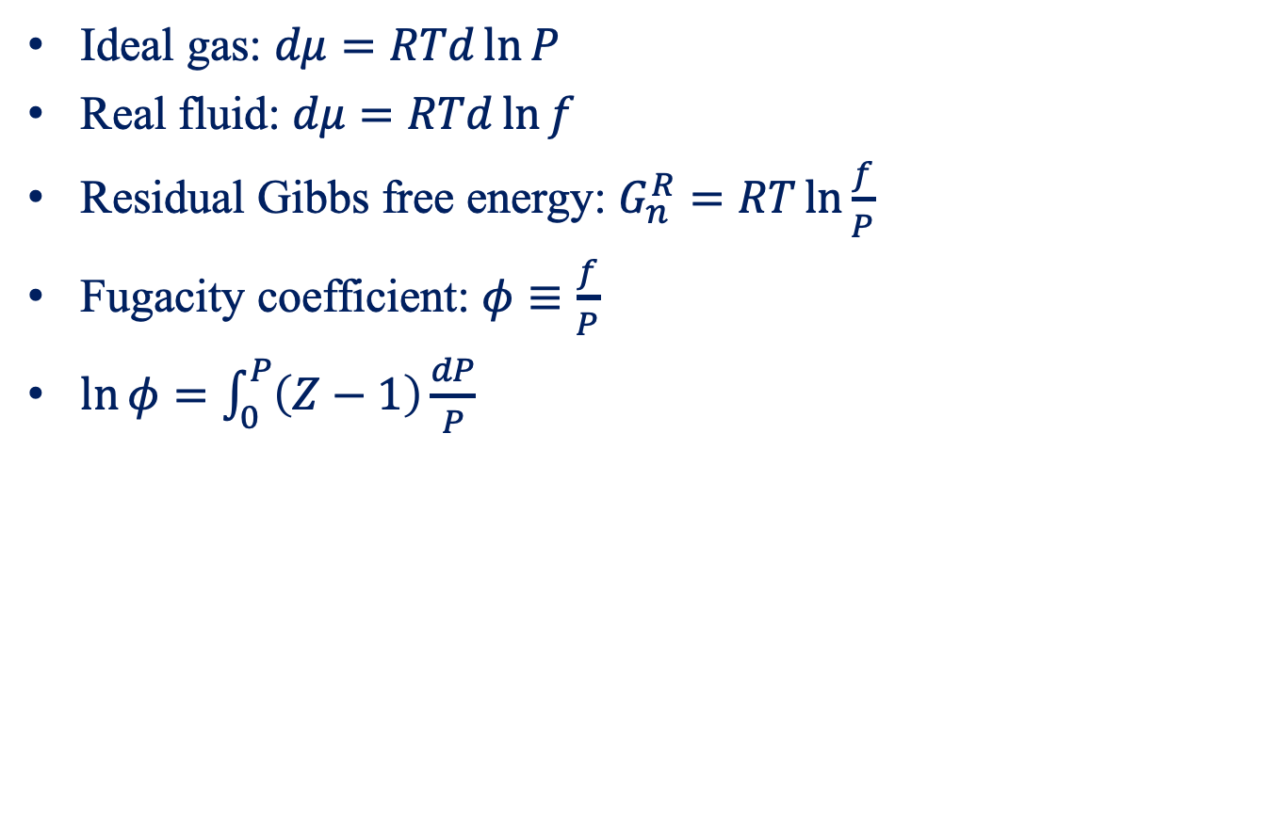
Fugacity of Pure Species
Ideal gas: $dμ=RTd\ln{P}$
Real fluid: $dμ=RTd\ln{f}$
Residual Gibbs free energy: $G_{n}^{R}=RT\ln{\frac{f}{P}}$
Fugacity coefficient: $φ≡\frac{f}{P}$
$\ln{φ=\int_{0}^{P}{\left(Z−1\right)\frac{dP}{P}}}$

Slide 16
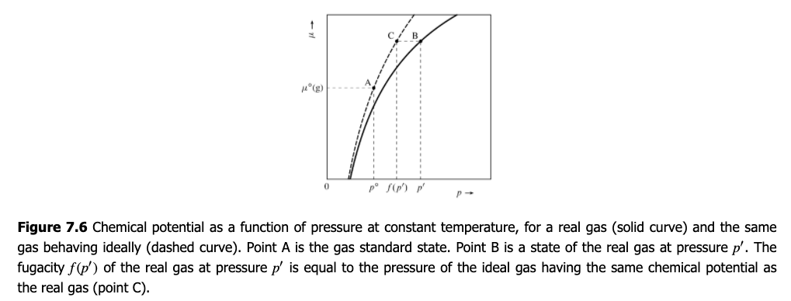
Fugacity

Slide 17
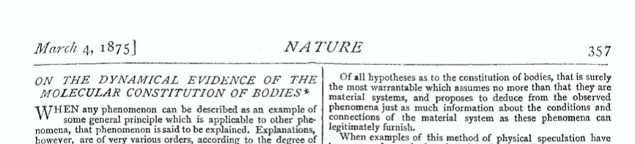
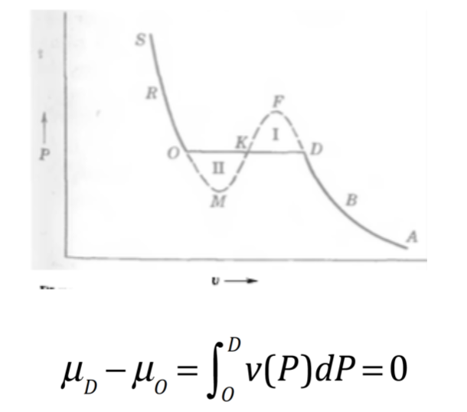
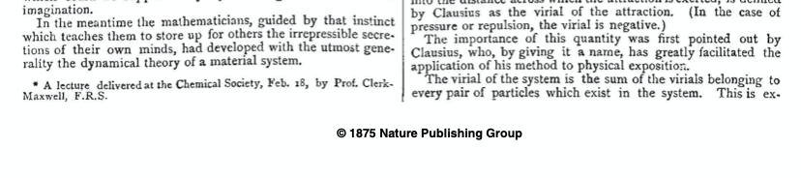
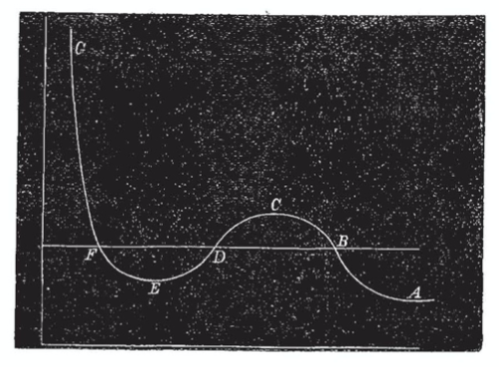
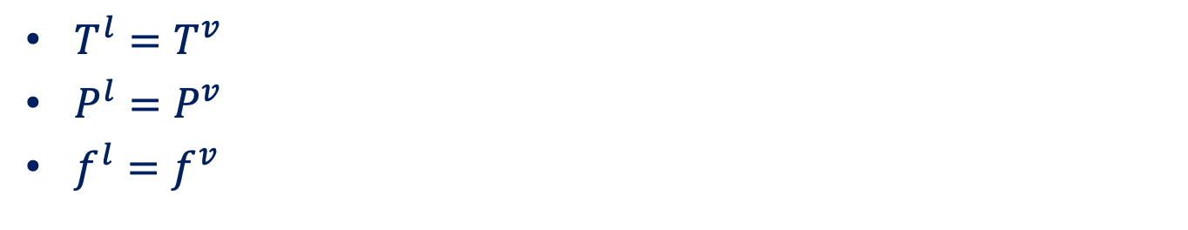
Vapor/Liquid Equilibrium for Pure Species
$T^{l}=T^{v}$
$P^{l}=P^{v}$
$f^{l}=f^{v}$
Maxwell’s construction
Nature, 1875, 11(279), 357

Slide 18
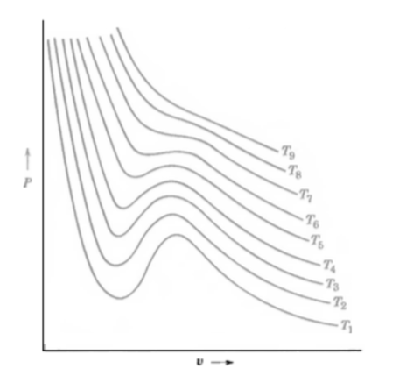
Isothermal Lines

Slide 19
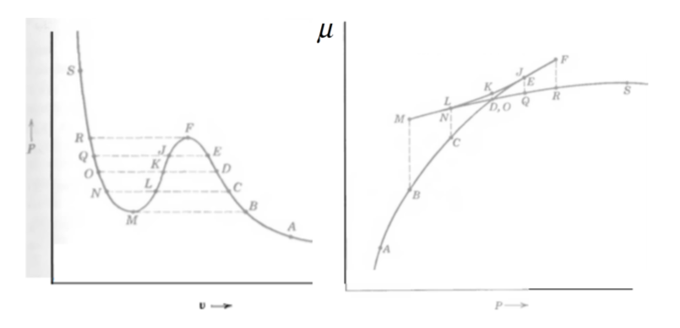
van der Waals Loops

Slide 20
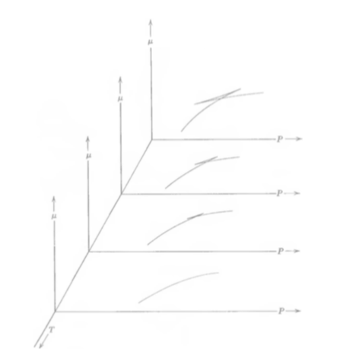
van der Waals loops versus T

Slide 21
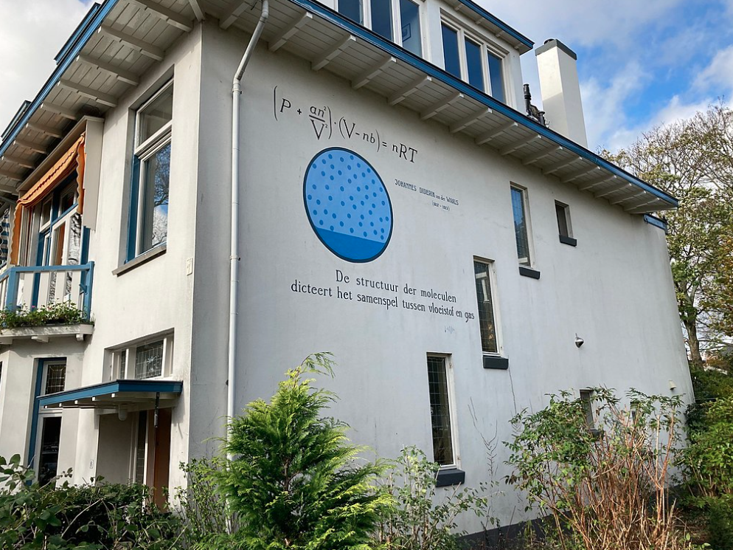
van der Waals EOS
van der Waals equation on a wall in Leiden

Slide 22
Numerical Methods to Find the Solution
Newton’s method
Binary search method
Mesh search method

Slide 23
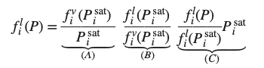
Fugacity of a Pure Liquid
A: vapor-phase fugacity coefficient
B: Ratio of liquid-phase fugacity to vapor-phase fugacity
C: The effect of pressure on the fugacity
Evaluate the fugacity of compressed liquid by using the data at saturation

Slide 24
Example

Slide 25
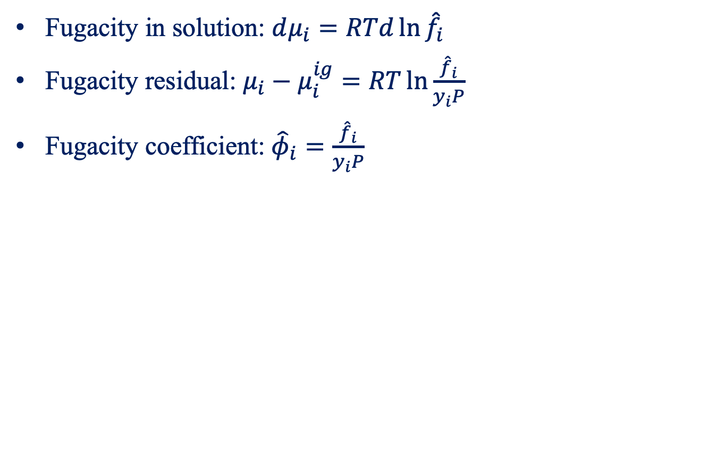
Fugacity of Species in Solution
Fugacity in solution: $dμ_{i}=RTd\ln{{\hat{f}}_{i}}$
Fugacity residual: $μ_{i}−μ_{i}^{ig}=RT\ln{\frac{{\hat{f}}_{i}}{y_{i}P}}$
Fugacity coefficient:${\hat{φ}}_{i}=\frac{{\hat{f}}_{i}}{y_{i}P}$

Slide 26
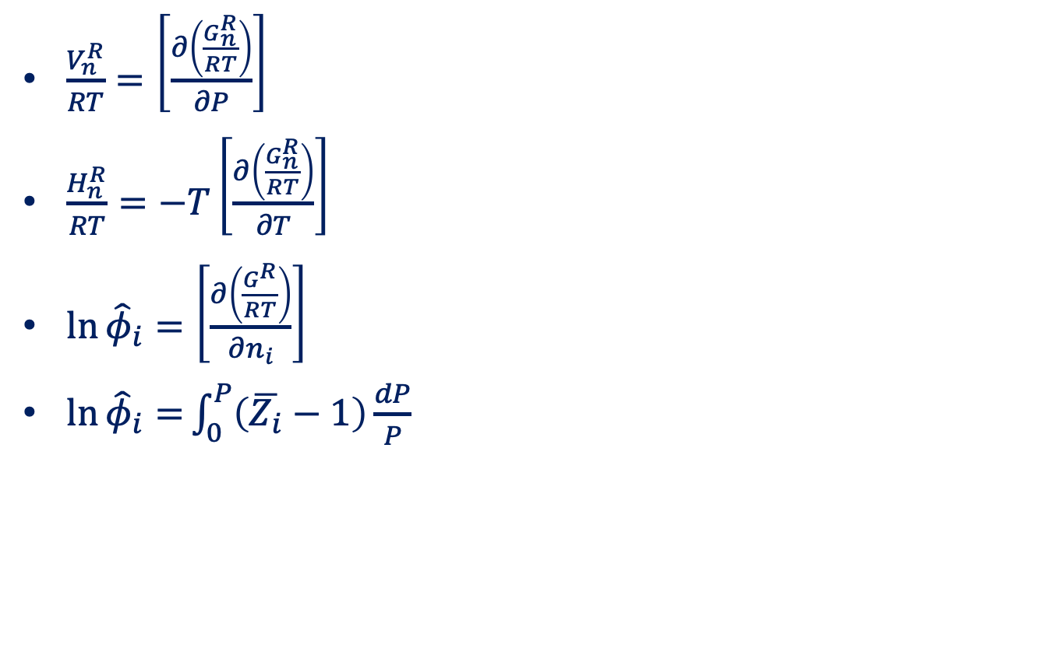
Some Important Formulas
$\frac{V_{n}^{R}}{RT}=\left[\frac{∂\left(\frac{G_{n}^{R}}{RT}\right)}{∂P}\right]$
$\frac{H_{n}^{R}}{RT}=−T\left[\frac{∂\left(\frac{G_{n}^{R}}{RT}\right)}{∂T}\right]$
$\ln{{\hat{φ}}_{i}=\left[\frac{∂\left(\frac{G^{R}}{RT}\right)}{∂n_{i}}\right]}$
$\ln{{\hat{φ}}_{i}=}\int_{0}^{P}{\left(\overline{Z_{i}}−1\right)\frac{dP}{P}}$

Slide 27
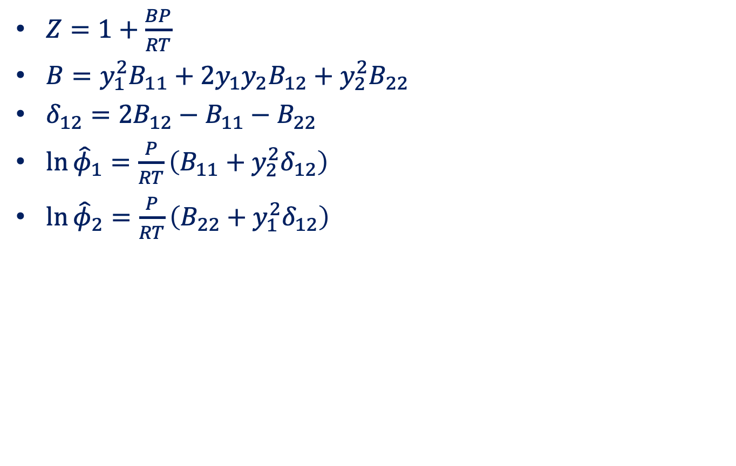
Fugacity Coefficients from the Virial EOS
$Z=1+\frac{BP}{RT}$
$B=y_{1}^{2}B_{11}+2y_{1}y_{2}B_{12}+y_{2}^{2}B_{22}$
$δ_{12}=2B_{12}−B_{11}−B_{22}$
$\ln{{\hat{φ}}_{1}}=\frac{P}{RT}\left(B_{11}+y_{2}^{2}δ_{12}\right)$
$\ln{{\hat{φ}}_{2}}=\frac{P}{RT}\left(B_{22}+y_{1}^{2}δ_{12}\right)$

Slide 28
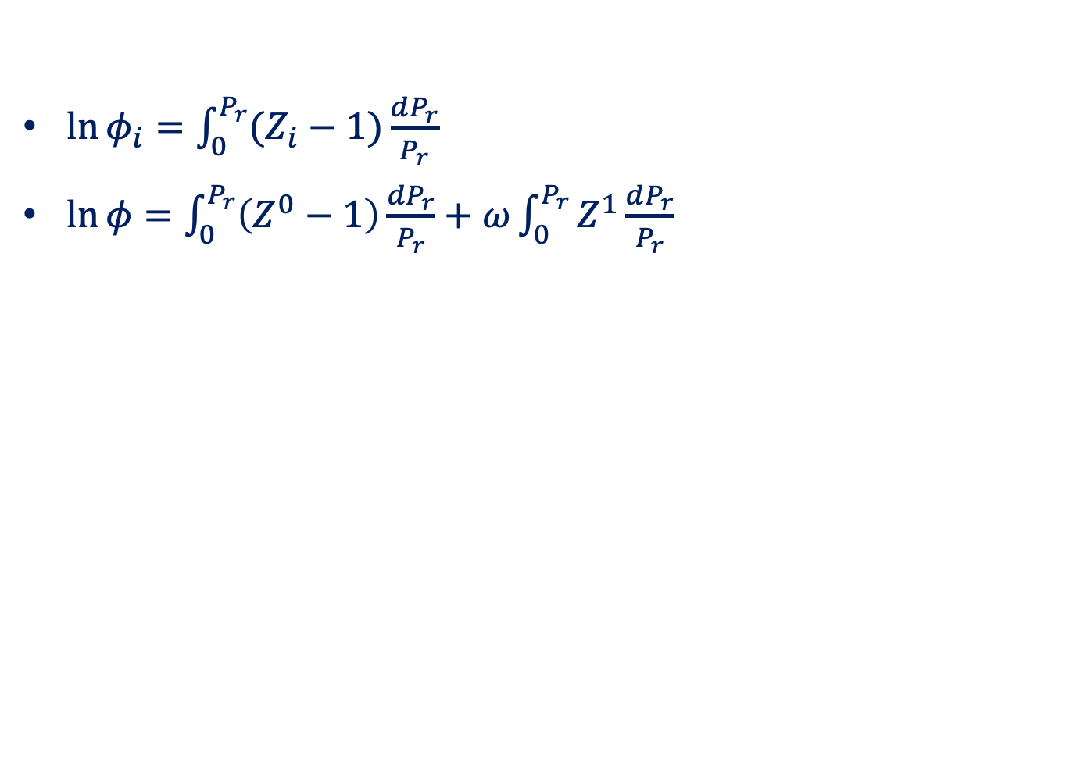
Generalized Correlations for the Fugacity Coefficient
$\ln{φ_{i}}=\int_{0}^{P_{r}}{(Z_{i}−1)\frac{dP_{r}}{P_{r}}}$
$\ln{φ}=\int_{0}^{P_{r}}{\left(Z^{0}−1\right)\frac{dP_{r}}{P_{r}}}+ω\int_{0}^{P_{r}}{Z^{1}\frac{dP_{r}}{P_{r}}}$

Slide 29
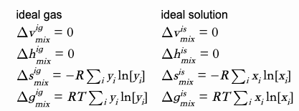
Ideal Gases versus Ideal Solutions
Ideal gas: molecules occupy no volume; no intermolecular interactions; real gas at low pressure
Ideal solution: molecules exhibit the same intermolecular interactions between all constituents; dilute solution or mixtures of molecularly-similar materials

Slide 30
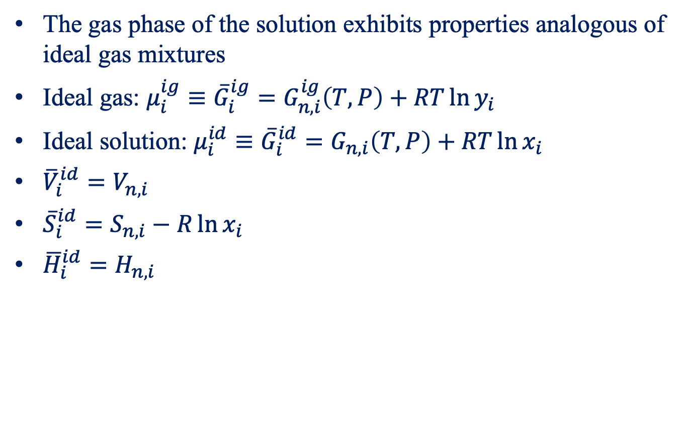
Ideal Solution
The gas phase of the solution exhibits properties analogous of ideal gas mixtures
Ideal gas: ${μ_{i}^{ig}≡\overline{G}}_{i}^{ig}=G_{n,i}^{ig}\left(T,P\right)+RT\ln{y_{i}}$
Ideal solution: $μ_{i}^{id}≡{\overline{G}}_{i}^{id}=G_{n,i}\left(T,P\right)+RT\ln{x_{i}}$
${\overline{V}}_{i}^{id}=V_{n,i}$
${\overline{S}}_{i}^{id}=S_{n,i}−R\ln{x_{i}}$
${\overline{H}}_{i}^{id}=H_{n,i}$

Slide 31
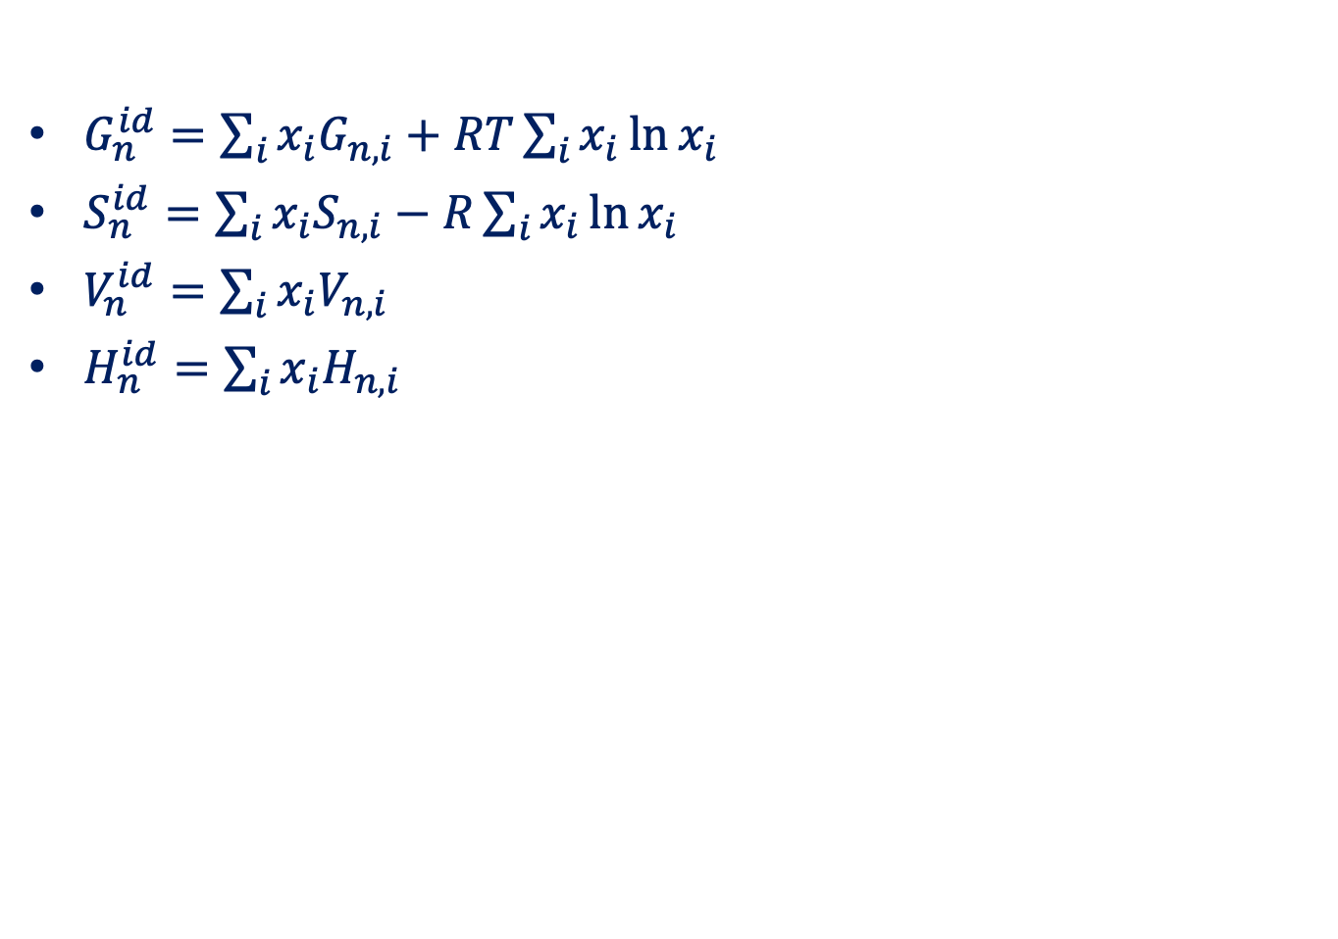
Ideal Solution
$G_{n}^{id}=\sum_{i}{x_{i}G_{n,i}+RT\sum_{i}{x_{i}\ln{x_{i}}}}$
$S_{n}^{id}=\sum_{i}{x_{i}S_{n,i}−R\sum_{i}{x_{i}\ln{x_{i}}}}$
$V_{n}^{id}=\sum_{i}{x_{i}V_{n,i}}$
$H_{n}^{id}=\sum_{i}{x_{i}H_{n,i}}$

Slide 32
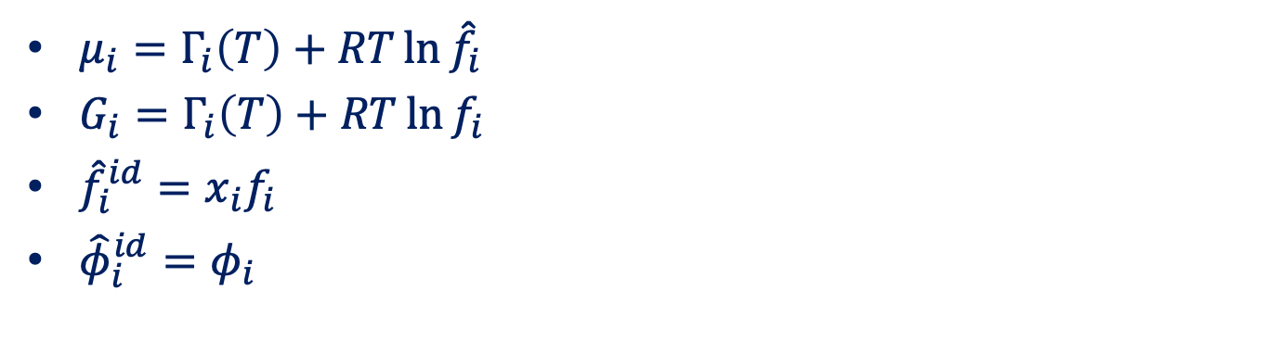
Lewis/Randall Rule
$μ_{i}=Γ_{i}\left(T\right)+RT\ln{{\hat{f}}_{i}}$
$G_{i}=Γ_{i}\left(T\right)+RT\ln{f_{i}}$
${\hat{f}}_{i}^{id}=x_{i}f_{i}$
${\hat{φ}}_{i}^{id}=φ_{i}$
The fugacity of each species in an ideal solution is proportional to its mole fraction.

Slide 33
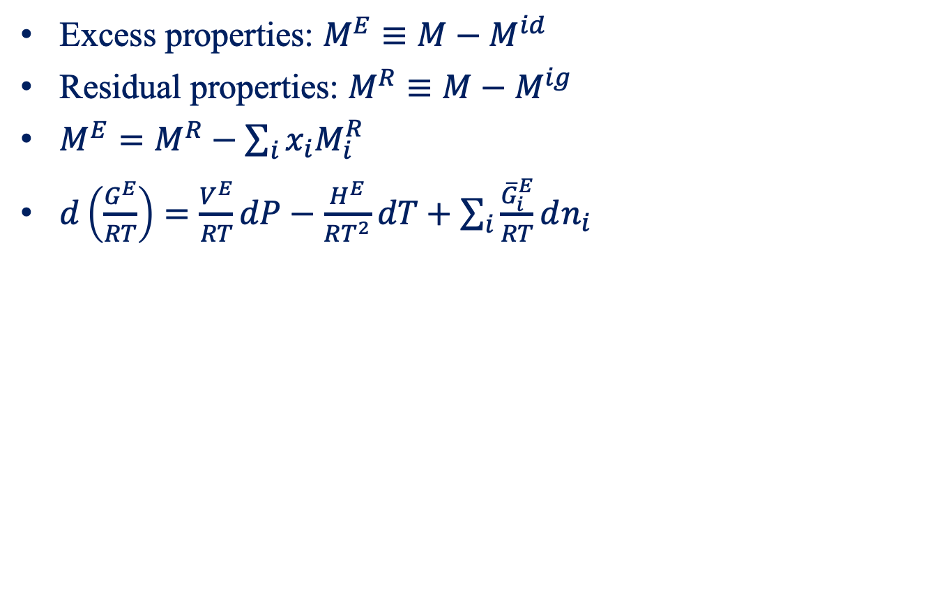
Excess Properties
Excess properties: $M^{E}≡M−M^{id}$
Residual properties: $M^{R}≡M−M^{ig}$
$M^{E}=M^{R}−\sum_{i}{x_{i}M_{i}^{R}}$
$d\left(\frac{G^{E}}{RT}\right)=\frac{V^{E}}{RT}dP−\frac{H^{E}}{RT^{2}}dT+\sum_{i}{\frac{{\overline{G}}_{i}^{E}}{RT}dn_{i}}$

Slide 34
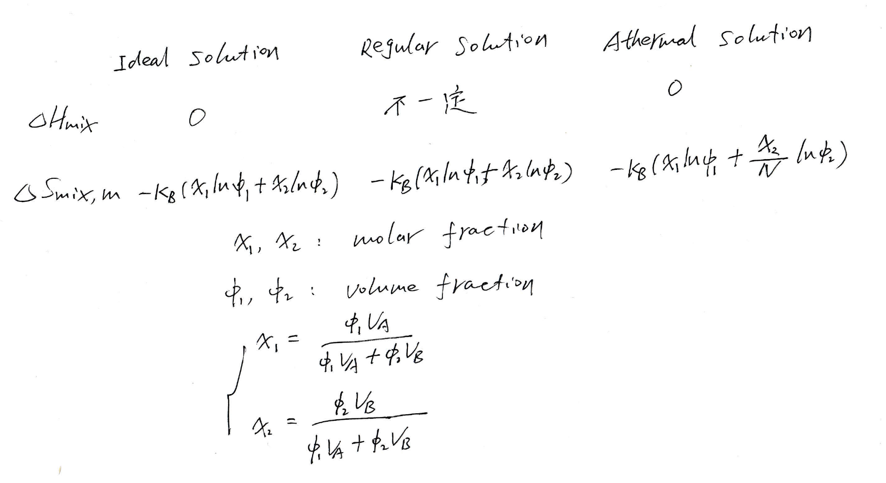
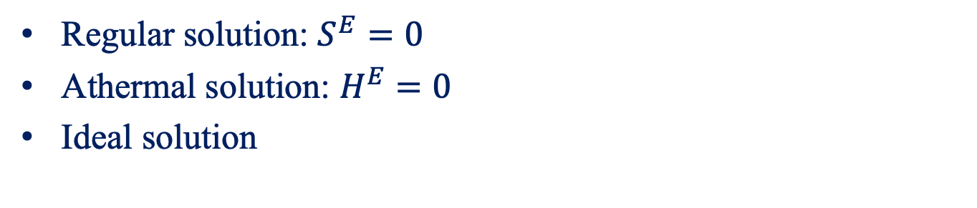
Typical Solution Models
Regular solution: $S^{E}=0$
Athermal solution: $H^{E}=0$
Ideal solution

Slide 35
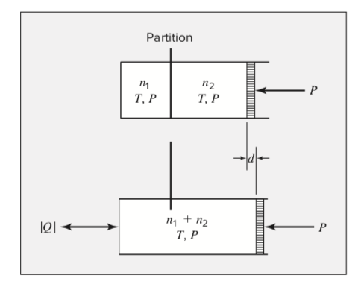
Mixing Processes
Standard mixing process: mixing at constant T and P.

Slide 36
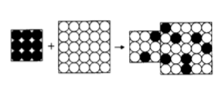
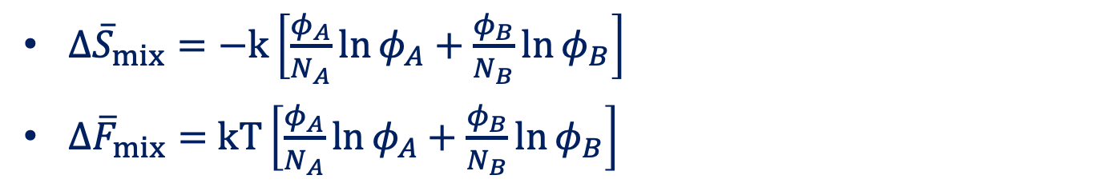
Entropy of Binary Random Mixing
$Δ{\overline{S}}_{mix}=−k\left[\frac{φ_{A}}{N_{A}}\ln{φ_{A}}+\frac{φ_{B}}{N_{B}}\ln{φ_{B}}\right]$
$Δ{\overline{F}}_{mix}=$ $kT\left[\frac{φ_{A}}{N_{A}}\ln{φ_{A}}+\frac{φ_{B}}{N_{B}}\ln{φ_{B}}\right]$

Slide 37

Energy of Binary Mixing
Flory interaction parameter:
$$χ≡\frac{z}{2kT}\left(2u_{AB}−u_{AA}−u_{BB}\right)$$
Free energy of mixing
$$Δ{\overline{F}}_{mix}=kT\left[\frac{φ}{N_{A}}\ln{φ}+\frac{1−φ}{N_{B}}\ln\left(1−φ\right)+χφ\left(1−φ\right)\right]$$

Slide 38



$χ$parameter
$χ\left(T\right)≈A+\frac{B}{T}$

Slide 39

Stability
Unstable, stable, metastable

Slide 40


Stability

Slide 41
Ideal mixture
Ideal mixture are stable always
Entropy always acts to promote mixing
Principle of entropy increase

Slide 42

Mixing at T=0 K
The mixing free energy is determined by the energy of mixing
$χ=A+\frac{B}{T}$
$B>0$: mixing is unfavorable
$B<0$: mixing is favorable

Slide 43

Real Mixture
Common tangent rule
Chemical potentials are balanced at equilibrium

Slide 44

Phase diagram
Binodal
Spinodal
Critical point

Slide 45

UCST and LCST

